Slide 1
Characteristics & Limitations: Security, Privacy, & Data Quality
Source of some materials:
Xiwei Xu, Ingo Weber, and Mark Staples. Architecture for Blockchain Applications. Springer, 2019

Slide 2
Outline
Security
Integrity
Confidentiality
Non-repudiation
Accountability
Authenticity
Security
Privacy
Data quality
Notes:
We’ll start with an introduction to security and discuss discuss several aspects of security like integrity and confidentiality.
Then, we’ll discuss about data privacy.
We’ll conclude the topic with a discussion on data quality on blockchain.
ISO quality model has security but not the other 2.

Slide 3
Security

Slide 4
Scope of Blockchain-Based Applications Security
Smart contracts
Blockchain platform
Consensus
Smart contract language & execution-environment
DApp architecture
Integration with external systems
Data management
Cryptography & Key management
Access control & KYC
Privacy
Infrastructure, especially for private blockchains
Business continuity & disaster recovery
Governance & compliance
Notes:
When we think about blockchain security, most people only consider smart contract security. Security testing of smart contracts includes both code-level testing and run-time testing.
But as we saw from the previous graph, to make sure a blockchain-based application is secure, we need to make sure many aspects/components of the system are secure.
This is ensured by secure design and extensive testing. What specific tests and depth of testing can depend on the importance of the application.
The choice of the blockchain platform is the main consideration. The key focus should be the blockchain platform’s consensus mechanism, its use of cryptography, and smart contract language and execution environment.
If the blockchain platform is well-established and time-tested you have some level of assurance and a good understanding of how it works.
If it’s a new platform, then you need to review and test everything from its design, protocols, and smart contract execution environment.
Software architecture should be designed to achieve security (i.e., secure by design). Architecture testing is a qualitative review of the design to determine its soundness in dealing with potential security issues.
Integration with external systems, how we manage data, cryptography and key management, access control and KYC, and privacy are other design considerations. They can also be tested once developed.
We should choose, configure, and test the infrastructure that was chosen to host the blockchain and other components of the application. This is particularly important for private blockchains.
Business continuity and disaster recovery are also important. If you are hosting the blockchain platform you need to think about the number of nodes and where they are located to enhance availability.
Blockchain governance is all about how you manage the platform from the addition of a new node and users, updating smart contracts to who pay for what and how issues are resolved.
If your application needs to comply with certain regulations, then you may also have some reporting requirements to show compliance. While some authority may run a node, you may still have other obligations to ensure you design the system considering such compliance needs and continue to operate satisfying these compliance needs.
So the following discussion applies to all aspects of smart contracts, blockchain, and components that integrate with it.
KYC – Know Your Customer

Slide 5
ISO/IEC 25010:2011 – Security Characteristics
Integrity
Degree to which a system prevents unauthorised access to, or modification of, computer programs or data
Confidentiality
Degree to which a system ensures that data are accessible only to those authorised to have access
Non-repudiation
Degree to which actions or events can be proven to have taken place, so that the events or actions can’t be repudiated later
Accountability
Degree to which actions of an entity can be traced uniquely to the entity
Authenticity
Degree to which identity of a subject or resource can be proved to be the one claimed
Only good writes & deletes
Only good reads
Undeniable
You did it!
Not fake
Notes:
ISO/IEC 25010:2011 standard includes several security characteristics.
While the CIA (confidentiality, integrity, and availability) triad in security includes availability, ISO/IEC 5010:2011 treats availability as a “reliability” characteristic.
Integrity is the degree to which a system, product, or component prevents unauthorised access to, or modification of, computer programs or data. This essentially means we should only allow good writes and deletes, e.g., no one without authorisation should be able to update a smart contract’s state.
Confidentiality is the degree to which a product or system ensures that data are accessible only to those authorised to have access. This means making sure only authorised users are allowed to read data, e.g., only the manager can add voters and restaurants.
Non-repudiation is the degree to which actions or events can be proven to have taken place so that the events or actions can’t be repudiated later. Essentially it is the inability to deny an action, e.g., if a transaction is signed with your private key, it authenticates you as the sender.
Accountability is the degree to which actions of an entity can be traced uniquely to the entity. This is about being able to pinpoint who did what, e.g., the ability to track voters and their votes.
Authenticity is the degree to which the identity of a subject or resource can be proved to be the one claimed. It is the ability to prove it is the real thing, e.g., proving the validity of an NFT. This also applies to the real-world identity of users as well.

Slide 6
Integrity
Clark-Wilson policy model is a classic model of integrity
Clark-Wilson Policy Model | How Blockchains Stack Up
Start with a well-formed initial state | Initial state (i.e., genesis block) is well-formed & cross-checked by all miners
Transformation procedures preserve well-formedness & checked using integrity validation procedures | Mining & cross-checking other miners’ blocks to ensure validity of TXs & blocks
Only authorised users make changes | Authorisation is checked using digital signatures
Separation of duty | No separation of duty enforced. “Admin changes” are by mining collective (i.e., governance body), e.g., hard forks
User actions are tracked | Ledger is system state & audit log
Notes:
Integrity is the degree to which a system, product, or component prevents unauthorised access to, or modification of, computer programs or data.
The Clark-Wilson policy model is a classic model of integrity.
Integrity is maintained by preventing the corruption of data items in a system due to either error or malicious intent. Based on double-entry bookkeeping.
Start with a well-formed initial state.
When changing the state, “transformation procedures” preserve state well-formedness.
“Integrity validation procedures” are used to check conditions for “constrained data items”.
Only authenticated and authorised users can make changes.
Also, ensure appropriate “separation of duty”, e.g., a party that initiates a transaction cannot approve the transaction.
Audit logs and controls on admin changes are tracked.
Clark-Wilson perspective on blockchain integrity
The initial state (i.e., genesis block) is well-formed and cross-checked by all miners.
Mining and cross-checking other miners’ blocks and transactions is a “Transformation Procedure”. Miners’ block validation checks are “Integrity Validation Procedure”. With the building of a new block, the system moves from one consistent discrete state to another.
Blocks and their transactions are the “Constrained Data Items”.
While the generation of a new block in public blockchains creates new cryptocurrency (or sometimes crypto is burnt to increase value), it is still within the rules of the system as the conversation of money is preserved as per the system rules.
An authorisation is checked using digital signatures. This applies to transactions and miners (in permissioned networks). No authentication on public blockchains! Often important on private blockchains.
No separation of duty is enforced. “Admin changes” are by the mining collective (i.e., governance body). When you don’t agree it can lead to a hard fork, the ultimate way of solving conflicts.
The blockchain ledger is the system state and audit log that track everything.
Example integrity conditions in blockchains:
Were transactions against an address signed by the corresponding private key?
Does the sending address have enough cryptocurrency?
Did a miner give themselves the right mining reward?
Did execution recorded for a smart contract give the same result I get?

Slide 7
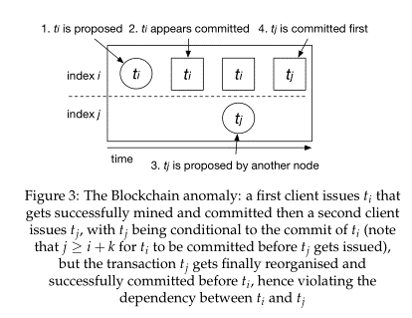
Integrity for Components in DApps
On-chain data integrity is preserved
Data may have been altered before recorded in blockchain (aka garbage in, garbage out problem)
Can enhance off-chain data integrity
Record data hash on-chain as Proof of Existence (PoE)
Record authorisations for off-chain data access on-chain
Smart contract cross-checks off-chain computations
TX order on blockchain & DApp may not be same
TXs from different addresses reorder
TXs from same address may reorder on some blockchains
Source: “The Blockchain Anomaly” https://arxiv.org/pdf/1605.05438
Notes:
Blockchains can enhance the integrity of components in blockchain-based applications.
As discussed in the previous slide, by design, blockchain maintains the integrity of data on-chain.
However, before submitting data to a blockchain, data may have been altered off-chain. E.g., while issuing a token that records the ownership of an asset, we may rely on an off-chain database to identify ownership information. If that database was compromised, we might be issuing a token to the wrong owner.
This problem is known as the “garbage in garbage out problem” because the blockchain can’t verify the integrity of data fed into the blockchain.
Blockchain can enhance off-chain data integrity, e.g.,
We can record the hash of data on-chain as proof of its exitance. This is called Proof of Existence (PoE). But we can’t recover data in case of an integrity violation.
We can also record authorisations for off-chain data access on-chain. This could also be done dynamically based on a set of transactions, we can record the authorisation on-chain that off-chain application components can check before allowing access to data.
A smart contract may cross-check off-chain computations to verify a certain computation was performed correctly.
We consider blockchain transactions to be in a strict order and immutable or are they?
Nakamoto consensus can give us alternative/replacement histories.
E.g., as seen in the figure, we first issue a transaction. Then we wait till it gets included in a block. Soon after, we issue a 2nd transaction that depends on the 1st one. But due to the Nakamoto consensus, 1st transaction may go back to the transaction pool and later get included in a block (or may never be included).
This is a possible anomaly where integrity is not preserved on-chain and off-chain.
Both need to be independently “valid” from the perspective of a blockchain and application. But it is invalid to the application when reordered. This is not a new problem. But something we need to be aware of and take action on if that’s a problem in certain cases.
TXs are known to record in blockchains.
Transactions from different addresses to the same receiver address could reorder.
Transactions from the same address may reorder on some blockchains.
There are some solutions to minimise the impact of these issues:
Wait for more confirmation blocks. But the question is how long?
Ethereum transaction nonce (this is different from block nonce) can order Transactions from the same sender address.
Smart contract to enforce/check order.

Slide 8
Confidentiality for DApps
Might Use … | But …
Pseudonymous addresses | If addresses are re-used, can recover identity information
Private blockchain | All nodes are authorised to see all data!
DLTs where ledgers & TXs are shared only with parties of interest, e.g., Hyperledger Fabric & R3 Corda | Orderer in Hyperledger Fabric see all TXs R3 Corda relies on notaries to prevent double-spending Patterns from TX analytics, e.g., volume & frequency Not straightforward to identify who can see what
Encryption for on-chain confidential data | Complex key management Limits what smart contracts can do with data Key loss reveals all old data Quantum computing or others may break crypto scheme
Keep data off-chain, use conventional technologies for access control | Limits data integrity Limits what smart contracts can do with data More complex system design Less value directly from blockchain for sharing data
Notes:
Confidentiality is the degree to which a product or system ensures that data are accessible only to those authorised to have access.
As we already discussed a couple of times, blockchain platforms aren’t good for confidentiality because mining nodes cross-check the contents of all transactions and maintain a copy of the ledger.
Even if a party doesn’t see the transaction data, they can still see metadata about them to understand things like transaction volume and frequency of interactions.
Here are a few examples of things one may try to enhance confidentiality and their limits
Other than in enterprise blockchains, we use pseudonymous addresses for accounts.
However, if addresses are re-used, one may be able to recover identity information by looking at IP addresses or linking to off-chain discussions to reveal the party. One solution is to use a new pseudo address for each transaction. While this work, it could be a management nightmare.
While confidentiality is better with private blockchains, as only the authorised parties are in the blockchain, all of them are authorised to see all transactions and ledger state.
You may try to further improve by using a private-permissioned blockchain/DLT where ledgers and transactions are shared only with parties of interest, e.g., R3 Corda & Hyperledger Fabric. However, we have the following challenges:
The orderer in Hyperledger Fabric sees all transactions. You can try to partition orders for different channels or use Private Data Collections (PDCs) which can be complicated to implement.
R3 Corda relies on notaries to prevent double-spending. So notaries see all transactions they attest. There’s some work to improve this; e.g., ING has proposed a technique to improve Corda privacy with zero-knowledge notaries.
Even though a 3rd party does not have access to transaction data or ledger, it can still analyse transaction patterns to identify which parties transact (remember that identities are typically known in private/enterprise blockchains), when, and how frequently.
Given many parties and complex policies, it’s not straightforward to identify who can see what?
Encryption for on-chain confidential data is another option. However, this comes with a few challenges:
This results in complex key management. E.g., you may need a different private/public key pair. Or if you use symmetric keys, they need to be shared with the party that is expected to decrypt the data.
Encrypted data substantially limits what smart contracts can do with them, e.g., while it’s possible to use homomorphic encryption to perform some operations on data (e.g., add and multiply), it’s quite limited and computationally expensive.
Also, a key loss reveals all old data too. This means we need to change the key, which further complicates key management frequently.
There is also the risk that quantum computing or other new techniques may break the crypto schemes in future.
Given all these troubles, one may try to keep data off-chain and rely on conventional technology for access control.
When you do this we lose the strong integrity guarantees that blockchains provide to data and limit what smart contracts can do with the data.
This may result in a more complex system design.
It also limits the value that you can gain from directly sharing data via blockchain.

Slide 9
Non-Repudiation
Immutable ledger state & TXs
Probabilistic immutability in Nakamoto consensus
Wait for a suitable number of confirmation blocks based on DApp’s risk profile
TX signature confirms integrity of TX data & sender’s address, but
Sender might have recorded false data in TX
Someone might have stolen the private key
Through a TX can record hash of off-chain data, nothing can be done if that data are modified or lost
Only have non-repudiation that TX happened
Notes:
Non-repudiation is the degree to which actions or events can be proven to have taken place so that the events or actions can’t be repudiated later. This about transaction sender not being able to deny the transaction.
Immutable ledger state and transactions prove what actions took place on the blockchain.
But be careful of probabilistic immutability in the Nakamoto consensus. An updated ledger state or transaction doesn’t mean anything if it’s not included in the heaviest chain.
Hence, we need to wait for a suitable number of confirmation blocks based on your application’s risk profile. While there are well-accepted numbers for different platforms (e.g., 6 for Bitcoin), you may want to wait a bit more if you need extremely high probabilistic guarantees.
A digital signature attached to a TX confirms the integrity of the data attached to the TX and the sender’s address. However, just because a transaction is signed and data are recorded on-chain, doesn’t mean it’s true!
The sender might have fraudulently recorded false data in a transaction.
Someone might have stolen your private key.
If the transaction includes hashes of off-chain data, need to retain the original data. Otherwise, nobody knows whether the data you recorded really mean anything.
Therefore, the only form of non-repudiation we have in blockchains is that TX happened, but not about its actual sender or the data it embeds.

Slide 10
Accountability
TX signature may be the only trace a party leaves
Does a single party control the private key?
Good key management is critical!
Most public blockchains try not to provide accountability
Pseudonymous IDs are too weak to prevent re-identification
Cryptocurrencies like Zcash, Dash, & Monero try to provide anonymity like cash
Private blockchains are normally permissioned; hence, know who users are
KYC/AML-CTF
Know Your Customer / Anti-Money Laundering, Counter-Terrorism Financing
e.g., Australian AUSTRAC regulation requires KYC/AML by crypto-currency exchanges
Authentication requires off-chain mechanisms to establish identity
Blockchain can be used to communicate or protect integrity of KYC information
Notes:
Accountability is the degree to which actions of an entity can be traced uniquely to the entity. This requires keeping track of everything to say who did what.
Transaction signature may be the only trace a party leaves (they may have additional traces based on data included in a transaction).
To understand who’s behind an account, we need to be sure whether only a single party controls the private key, e.g., the key could be compromised or shared (people still share passwords).
Therefore, good key management is critical to ensure authenticity.
Most public blockchains try not to provide accountability by hiding the identity of transacting parties.
However, pseudonymous IDs in Bitcoin and Ethereum are too weak to prevent re-identification as they can be linked to IP addresses, withdrawals at exchanges, or even some social media discussions.
Cryptocurrencies like Zcash, Dash, and Monero try to provide anonymity like cash using techniques like transaction mixing services, zero-knowledge proofs, and ring signatures (a signature generated by multiple parties). Such coins are called “privacy coins“ See https://www.comparitech.com/crypto/anonymous-cryptocurrency-monerto-zcash/ for details.
Private blockchains are normally permissioned; hence, know who the users are. Typically use digital certificates issued by trusted certificate authorities.
We need to consider KYC/AML-CTF regulations
KYC – Know Your Customer
AML – Anti-Money Laundering
CFT – Counter-Terrorism Financing
E.g., Australian AUSTRAC regulation requires KYC/AML by cryptocurrency exchanges. However, this can’t be enforced at decentralised exchanges
Authentication required by these regulations requires some off-chain mechanism(s) to establish an identity.
Blockchain can be used to communicate or protect the integrity of KYC information, e.g. a trusted party may issue a certificate that is stored on a blockchain to confirm one’s self-sovereign identity.

Slide 11
Authenticity
Many blockchain-based applications try to improve authenticity of a party or asset
E.g., digital identity, NFTs, & goods on a supply chain
Digital assets
Blockchains can ensure authenticity of entirely on-chain assets
Hard to guarantee for other digital assets
Physical assets
Hard to guarantee
A unique physical “fingerprint”, e.g., DNA, diamonds, chemical composition?
Blockchain can track authoritative data signed by an authority confirming its authenticity
E.g., Oracles
Notes:
Authenticity is the degree to which the identity of a subject or resource can be proved to be the one claimed, i.e., it’s the real thing.
Many blockchain-based applications try to improve the authenticity of a party or asset, e.g., digital identity, non-fungible tokens, and goods on a supply chain.
However, we need to be clear whether the authenticity is about the identity/asset or its container/reference.
Digital assets
Blockchains can ensure the authenticity of assets entirely on-chain, e.g., Cryptokitties.
However, it is hard to guarantee other digital assets, e.g., NFT may include a URL of a digital asset. But it doesn’t mean there’s only one copy, and NFT represents only that asset. Digital watermarking help. But not straightforward to use.
Physical assets are interesting
Typically it’s hard to guarantee the authenticity of an asset purely on-chain.
However, some of the physical assets may contain unique physical fingerprints like DNA, unique patterns on a diamond/opal, and chemical composition. So the question is how representative are those data, whether can they be stored on-chain, and whether it’s acceptable given an application’s risk appetite.
Blockchain can track authoritative data signed by an authority confirming its authenticity. Here blockchain proves the authenticity of the record signed by the authority and the actual authenticity of the asset is a claim of the authority.
Oracles are key components that connect the blockchain’s virtual world with the real world in bringing such authoritative data into a blockchain. We trust the oracle or set of oracles.

Slide 12
Privacy

Slide 13

Privacy
Similar but different to confidentiality
Simple distinction – confidentiality is about data, & privacy is about individual
Privacy is an individual’s desire to control access of others to themselves & not just information
Having control over extent, timing, & circumstances of sharing oneself
e.g., physical privacy in your house, privacy on your crypto-asset ownership
Individual can be a person, organisation, or an entity
Even for information, privacy has different regulations than confidentiality
Privacy Act in Australia, General Data Protection Regulation (GDPR) in Europe
Confidentiality comes from common law
Privacy is more than preventing unauthorised access to confidential, private, or other sensitive information
Also, about what data are being collected, how & why data are shared or used …
Notes:
Data breaches and misuse is a constant and common problems.
Words “confidentiality” and “privacy” are often confused or perceived to be equivalent terms, but they represent related but different concepts.
A simple way to think about these 2 terms is that confidentiality is about the data, and privacy is about the individual.
E.g., by protecting the confidentiality of your trading data, the privacy of your wealth can be protected.
Privacy is an individual’s desire to control access of others to themselves and not just information.
It is the ability of an individual or group to seclude themselves or information about themselves, and thereby express themselves selectively. It can be defined in terms of having control over the extent, timing, and circumstances of sharing oneself (physically, behaviourally, or intellectually) with others.
E.g., What you want to share, when you want to share, and how you want to share. Physical privacy in your home or privacy of on assets you own.
The individual doesn’t have to be a person, it can be an organisation or any distinct entity. But when it comes to most privacy legislation, it is about an individual’s privacy. So, to distinguish individual’s privacy from business privacy we sometimes use the term ’business confidentiality’.
While privacy is governed by the Privacy Act, confidentiality isn’t covered by a specific law. Instead, it comes from common law.
Key regulation that applies to data is General Data Protection Regulation (GDPR) in Europe.
Guaranteeing privacy means guaranteeing that data can’t uniquely identify any individual.
However, privacy is more than preventing unauthorised access to confidential, private, or other sensitive information.
It also includes aspects like what data are being collected, how and why data are shared or used.

Slide 14
Requirements of Privacy Regulations
Privacy Requirements | Blockchain Support
Access (& timeliness of access) – right to access their personal data without undue delay | Permissionless blockchains – Open to all Permissioned blockchains – Possible to grant timely access
Rectification – right to correct inaccurate data concerning him/her | Append only Depends on ownership of ledger state
Restriction of usage – right to consent to use | Smart contracts can make both consent & usage transparent & auditable Permissioned blockchains – Possible to grant appropriate access Permissionless blockchains – Open to all?
Notes:
Blockchain applications need to comply with regulations, but are there challenges or limitations?
Typically privacy regulations specify a set of requirements. Here we compare key privacy requirements from GDPR and the level at that blockchains can support them.
Access and timeliness of access is the right to access one’s personal data without undue delay
Permissionless blockchains are open to all hence satisfy this requirement.
Whereas permissioned blockchains hide data from certain parties. However, if there’s a need, it’s possible to grant timely access.
Rectification is the right to correct inaccurate data concerning him/her.
Blockchains are append-only. So what we can do is to send another transaction to update the data. However, this means both incorrect and correct data remain on the platform, with the information that incorrect data were superseded by correct data.
However, this depends on the ownership of the ledger state. If someone adds false data about you and if you don’t have access to that smart contract you can’t fix it.
Restriction of usage is the right to consent to use.
Smart contracts can make both consent and usage transparent and auditable.
With permissioned blockchains it is possible to grant appropriate access.
However, with permissionless blockchains data are open to all, meaning we can’t meet this requirement.

Slide 15
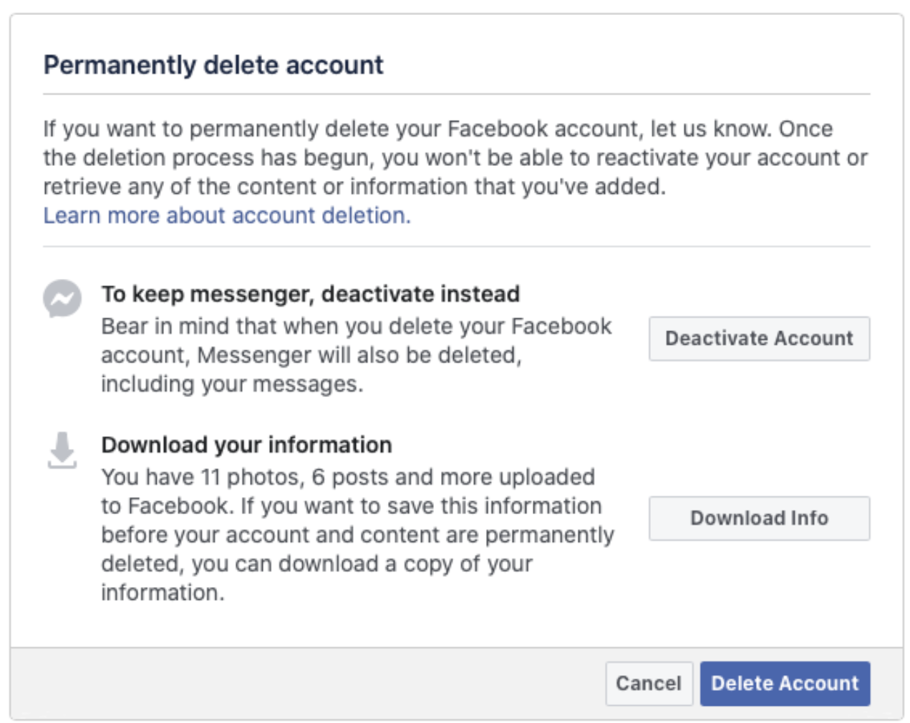
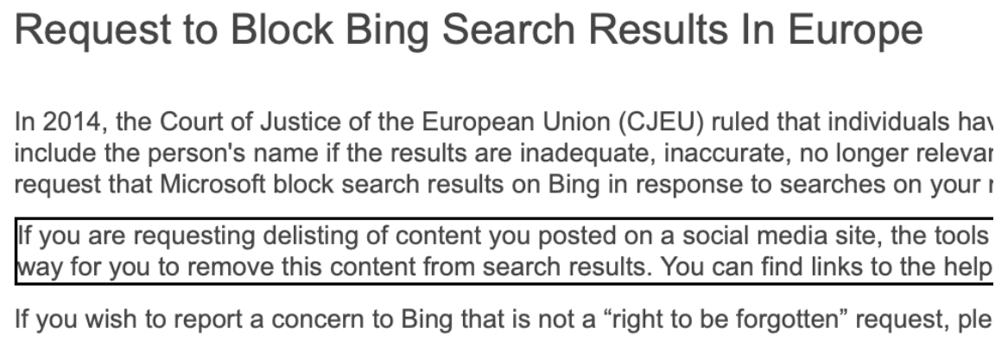
Requirements of Privacy Regulations (Cont.)
Privacy Requirements | Blockchain Support
Portability of personal data – right to receive personal data in a machine-readable format for portability with other services | Machine-readable, e.g., JSON May not be portable
Right to be forgotten – right to remove personal data concerning him/her without undue delay | Append only
Notes:
Portability of personal data is the right to receive personal data in a machine-readable format for portability with other services.
The data format in blockchains is machine-readable, e.g., JSON. However, moving the data between blockchain platforms is not straightforward (e.g., moving all the history of a user account). Also, semantics may be different across blockchain platforms, e.g., UTXO vs account-balances. Lack of smart contract support or lack of representation like floating point numbers.
The right to be forgotten is the right to remove personal data concerning him/her without undue delay. This is one of the hardest aspects of GDPR to comply with.
Blockchains are immutable by design; hence, removing data to comply with this requirement is not feasible
A possible approach be to store any sensitive data off-chain and maintain a ”link” between a blockchain transaction record and the off-chain data.
Here are 2 examples of Bing and Facebook support right to be forgotten. As a search engine, Bing will “try to” prevent access to some data.

Slide 16
Data Quality

Slide 17
Data Quality
Strong data security guarantees may incentivise more data contributions
However, value of data depends on its quality
Need to prevent garbage-in, garbage-out
More quality data could lead to better business outcomes for all stakeholders
Storing data on-chain doesn’t automatically increase data quality
Notes:
Strong data security guarantees may incentivise more data contributions from users.
However, the value of data depends on its quality not so much on the volume.
As discussed earlier, we need to prevent garbage-in, garbage-out scenarios.
More quality data could lead to better business outcomes for all stakeholders.
However, just because we store data on-chain doesn’t automatically increase data quality.

Slide 18
Data Quality in Blockchains
Data Quality Attributes | Blockchain Support
Consistency – data are free from contradiction | Strong integrity properties
Traceability – audit trail of access/changes to data | Immutable ledger Accountability in private blockchains
Availability – data readily accessible | High read availability, low write availability
Compliance – data compliant with standards or regulations | Protocol-level checks are quite limiting Smart contracts are flexible, but have limitations
Confidentiality – data only accessible to authorised users | Private blockchains are better, but have limitations
Credibility – data regarded as true & believable by users | Only for entirely on-chain assets For others, we must trust an oracle
Notes:
Blockchains natively provide some quality guarantees regarding the data stored on them. Data quality can be assessed using a range of dimensions, some of which are detailed below:
Consistency means that data are free from contradiction. This can be achieved due to the strong integrity properties of blockchains provided through immutability.
Traceability means we need to have an audit trail of access/changes to data. Immutable ledger captures everything so we have an audit trail. In public blockchains, we also get accountability where we also know who changed the data.
Availability makes data readily accessible. As discussed many a time blockchains have high read availability, but low write availability.
Compliance ensures data are compliant with standards or regulations. Protocol-level checks are quite limiting as they don’t focus on such aspects or even want to work against regulation. Smart contracts are flexible when it comes to embedding compliance rules, but have limitations on how expressive they can be or complex conditions to handle.
Confidentiality ensures data are only accessible to authorised users. Private blockchains are better as they can at least hide transaction details, but have limitations as they may still reveal secondary information like who is transacting with whom and how frequently.
Credibility is about authenticity where data can be regarded as true and believable by users. As discussed earlier, authenticity can be ensured only for entirely on-chain assets. For others, we have to trust an oracle.
Trustworthy data sources are integral parts of blockchain networks, but it is not subject to the underlying security mechanisms of blockchain technology.

Slide 19
How Architects Can Improving Data Quality in Blockchains?
Apply a hybrid on-chain & off-chain data architecture
Credibility
Data sources aren’t subject to underlying security mechanisms of blockchain
Source data from multiple oracles
Use assurance certificates from auditors
Record lineage of off-chain data on-chain
Utilise a reputation management system or align incentives
Compliance
Use smart contracts for simple quality/compliance assessments that are unlikely to change
Perform complex or likely-to-change compliance assessments off-chain & record a proof on-chain
Notes:
Managing data quality is an on-going issue and protocol and smart contracts are not flexible enough for compliance checking.
Therefore we may need a hybrid of on-chain and off-chain data architecture.
When it comes to data credibility data sources are not subject to the underlying security mechanisms of blockchain technology. Therefore, we don’t have any control over them or independently validate their behaviour/data.
Possibly we can try to source data from multiple oracles so that we don’t have to trust one party. This may happen through oracles we discussed so far it could be more qualitative like getting a certificate from a certified assurance body.
Blockchain is good to recording the lineage of off-chain data, i.e., storing everything about data like its generation, transformation, and storage.
Another option is to utilise some reputation management system to enhance trust in parties providing data. Alternatively, incentives can be set such that we penalise bad behaviour.
To enhance data or business process compliance
We can use smart contracts to encode and enforce simple quality/compliance assessments that are unlikely to change in the near future. Rules that are likely to change are not good to be put on a smart contract as the contract need to be upgrades whenever compliance rules change.
Perform complex or likely-to-change compliance assessments off-chain. This can be supplemented with on on-chain proof general by specialised hardware like Intel SGX.

Slide 20
Question
Mark True or False for each the following statements
 | True | False
The trust in a blockchain-based application solely relies on the trust in the blockchain platform
A blockchain can ensure the authenticity of a digital asset stored off-chain
Encrypt on-chain data pattern can’t provide privacy forever
Blockchain anomaly is an example of loss of integrity on a blockchain platform
Blockchains can’t generally support the “right to be forgotten” privacy requirement
✓
✓
✓
✓
✓
Notes:
False – The trust in a blockchain-based application relies on blockchain and all other components of that application.
False – A blockchain cannot always ensure the authenticity of a digital asset stored off-chain, e.g., think about an NFT for digital art stored off-chain.
True – Encrypt on-chain data patterns can’t provide privacy forever as keys can be compromised and technology enhancements may render current encryption algorithms useless, e.g., quantum computing.
True – Blockchain anomaly is an example of loss of integrity on a blockchain platform as order of transaction recording on-chain and off-chain can be different.
False – Blockchains can’t generally support the right to be forgotten privacy requirement as it is immutable. There’s some effort to develop redactable blockchains where you can remove selected data without breaking consensus process.

